Slide 1
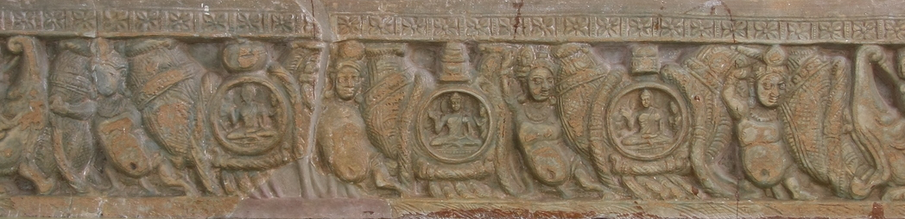
DEVELOPING A TELUGU LANGUAGE – VISUAL QUESTION ANSWERING SYSTEM FOR MUSEUM ARTIFACTS
a presentation by
GURURAJA, SANTOSH, ANKUR, HIMANSHU

Slide 2
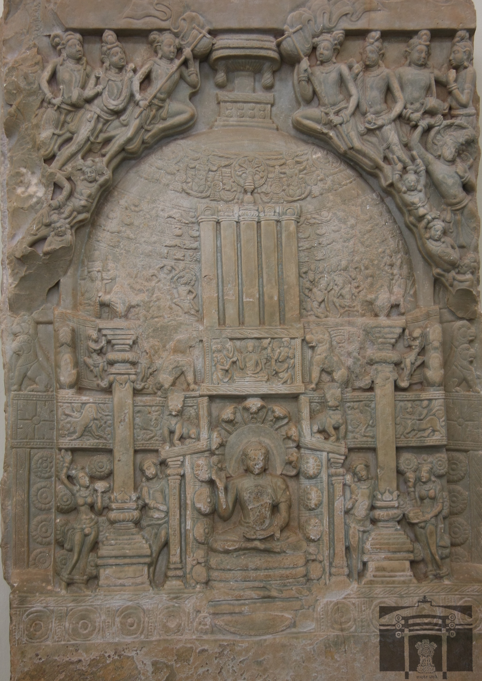
Agenda
1 | Data scraping
2 | QuestionS Collection
3 | Translation
4 | Finetuning
5 | Deployment

Slide 3
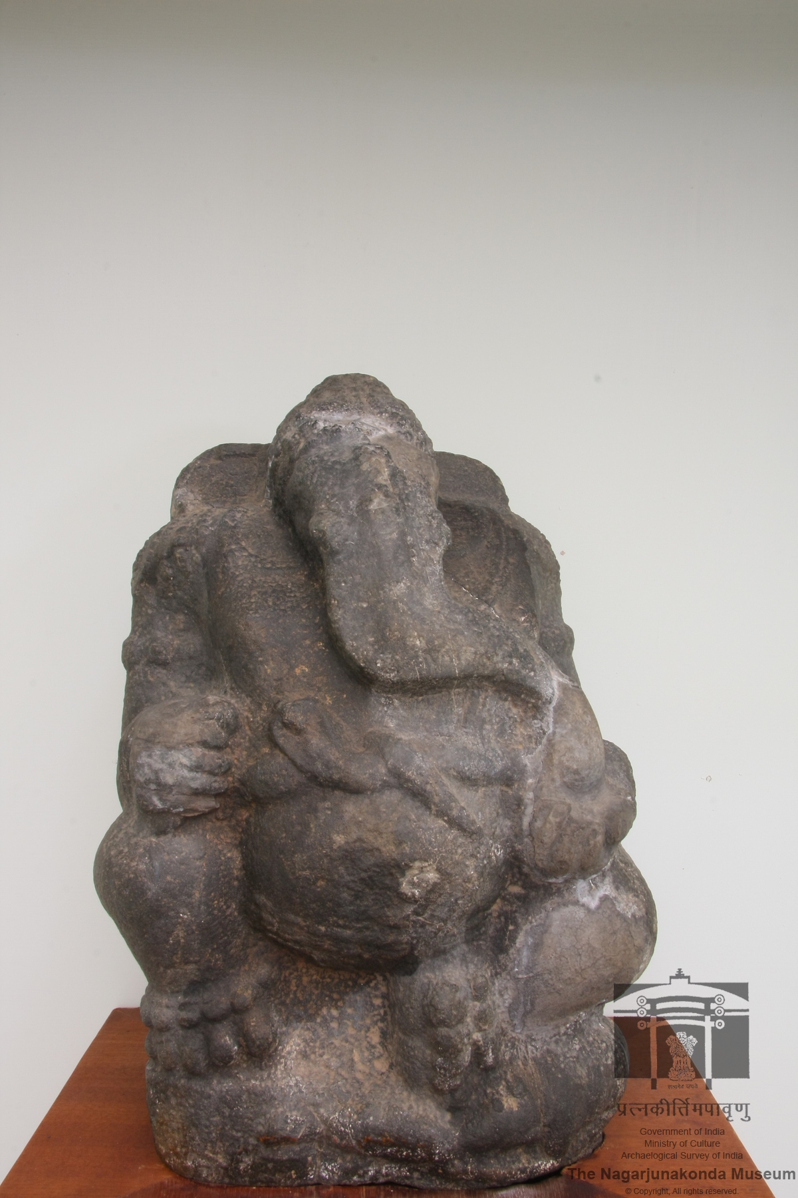
INTRODUCTION
Visual Question Answering (VQA) system capable of interpreting and answering questions posed in Telugu about sculptures of Nagarjuna Konda Museum images,
Utilizing the fine-tuning capabilities of the state-of-the-art model provided by Hugging Face

Slide 4
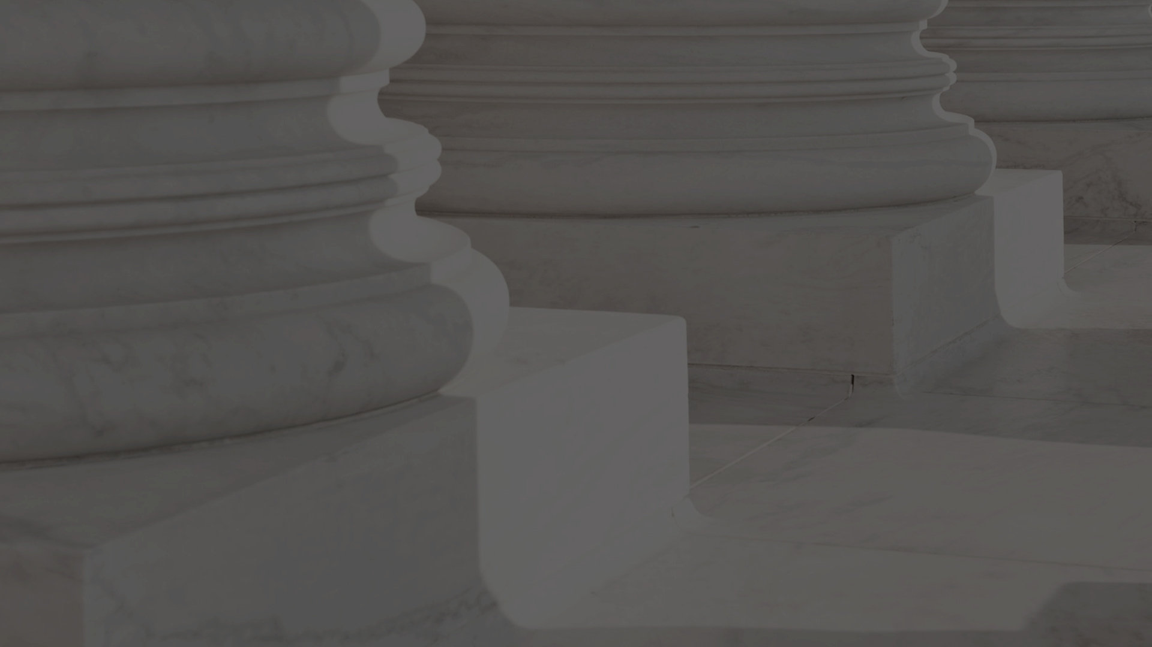
DATA SCRAPING
DL FOR NLP

Slide 5
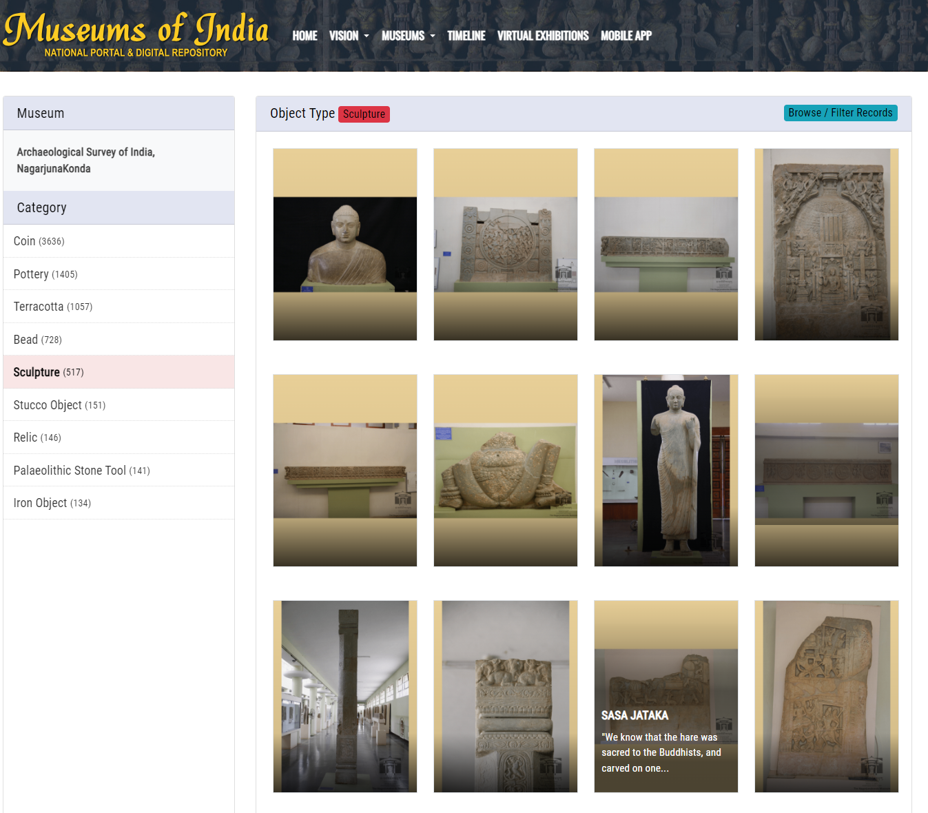
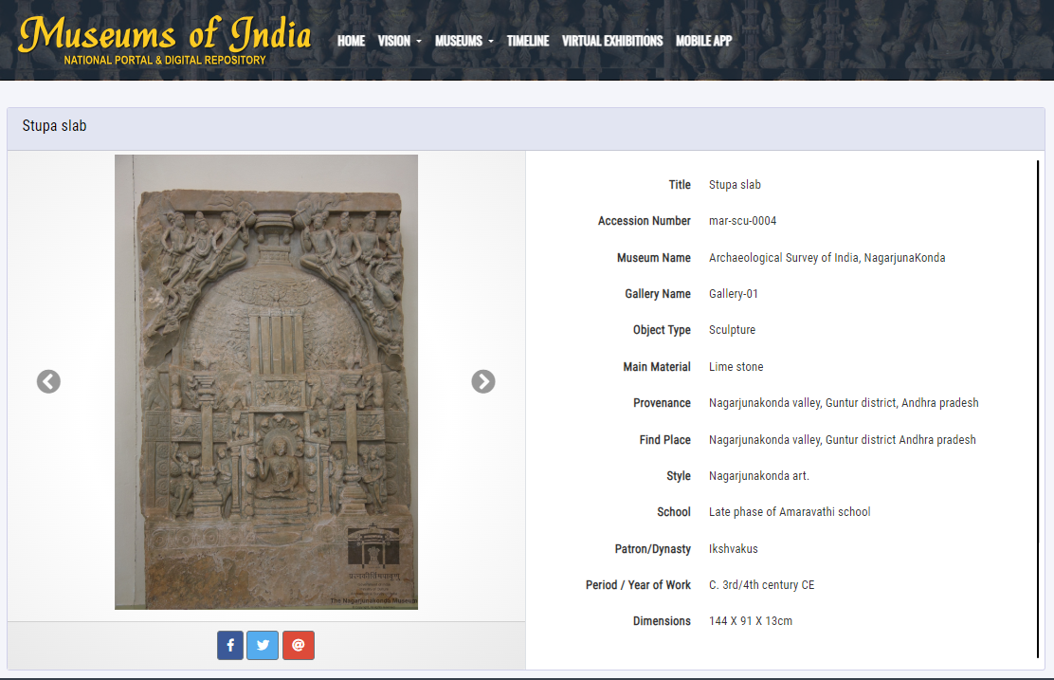
DATA SCRAPING

Slide 6
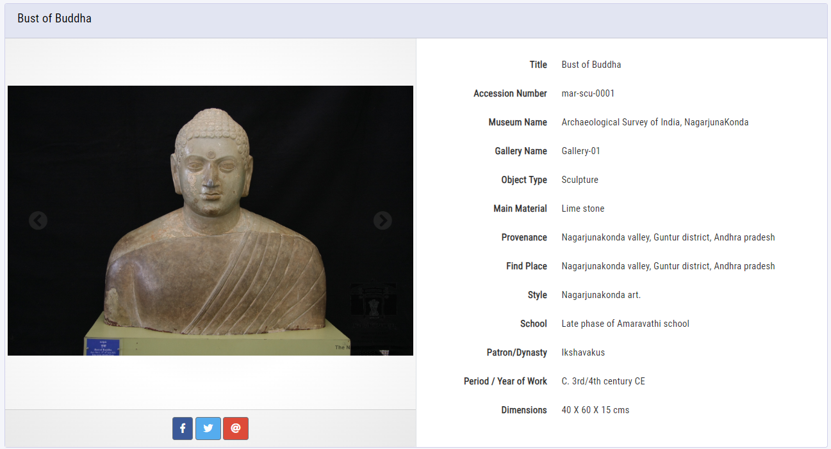
DATA SCRAPING
TOTAL 125 SCULPTURE DATA POINTS
SCRAPED TO JSON FORMAT

Slide 7
DATA SCRAPING USING SCRAPY-SPLASH
Imports and Setup:
The script imports necessary libraries like scrapy and scrapy_splash.
A MuseumSpider class is defined, inheriting from scrapy.Spider.
Spider Configuration:
name specifies the spider's name.
allowed_domains limits the domains that the spider will scrape.
start_urls contains a list of URLs from which the scraping begins.
Start Requests:
The start_requests method utilizes a Lua script for interaction with Splash, ensuring all dynamic content is loaded.
SplashRequest is used to make requests, incorporating the Lua script to handle JavaScript rendering.
Data Parsing:
The parse method extracts detailed table data and image URLs from the page content.
It navigates HTML elements using XPath to locate and extract data like title, dimensions, and descriptions of artifacts.
Images are processed to ensure that URLs are complete and accessible.
Spider Execution:
Conditions for running the spider are set, including user agent and settings for handling JavaScript and caching.
The script can be executed directly, using Scrapy's CrawlerProcess to initiate the spider.

Slide 8
Challenges and Considerations:
JavaScript Content: Handling JavaScript-heavy sites with Splash to ensure all relevant data is loaded and accessible.
Data Quality: Ensuring that extracted data maintains its integrity and accuracy, essential for subsequent training stages of the VQA system.
Rate Limiting and Respect for Targets: Implementing delay between requests to avoid overwhelming the server and adhering to robots.txt directives.

Slide 9
QUESTIONS COLLECTION & DATA TRANSFORMATION
DL FOR NLP

Slide 10
USER & ASSISTANT - QUERY& ANSWERS
100 Questions & Answers formulated based on :
Object Specific Questions,
Generalised Questions,
Paraphrased Questions,
Short and Long Length Questions,
No. | Question (Telugu) | Question (English) | Answer (English) | Answer (Telugu)
1 | ఈ శిల్పాన్ని ఏమని పిలుస్తారు? | What's this sculpture called? | It's called the "Bust of Buddha." | దీనిని "బుద్ధ బస్ట్" అని పిలుస్తారు.
2 | ఇది ఏ రకమైన వస్తువు? | What type of object is this? | This is a sculpture. | ఇది ఒక శిల్పం.
3 | ఈ శిల్పం దేనితో తయారు చేసారు ? | What material is this sculpture made of? | The sculpture is made of limestone. | ఈ శిల్పం సున్నపురాయితో చేయబడింది.
4 | ఈ శిల్పం యొక్క శైలి ఏమిటి? | What is the style of this sculpture? | This sculpture is in the Nagarjunakonda art style. | ఈ శిల్పం నాగార్జునకొండ కళా శైలిలో ఉంది.
5 | ఈ శిల్పం ఏ కాలం నుండి వచ్చింది? | What time period does this sculpture come from? | This sculpture is from around the 3rd or 4th century CE. | ఈ శిల్పం క్రీ.శ. 3వ లేదా 4వ శతాబ్దం నుండి వచ్చింది.

Slide 11
DATA TRANSFORMATION
To prepare data for model training, transform the scraped data into a structured format suitable for a VQA system. This involved pairing questions with appropriate images and their metadata, then formatting them in a way that aligns with the model’s input requirements.
Output Example:
User Query: "What is the official title of this artwork?"
Assistant Response: "Stupa slab"
Image Reference: Links(file path) to the images or image IDs.
This structured pairing ensures that the model can be trained to understand the context of the question and retrieve or generate the correct answer based on the image and associated metadata.
Challenges:
Ensuring that the data format is compatible with the model’s requirements.
Maintaining the accuracy and relevance of the questions to the visual content.

Slide 12
TELUGU TO ENGLISH TRANSLATOR
DL FOR NLP

Slide 13
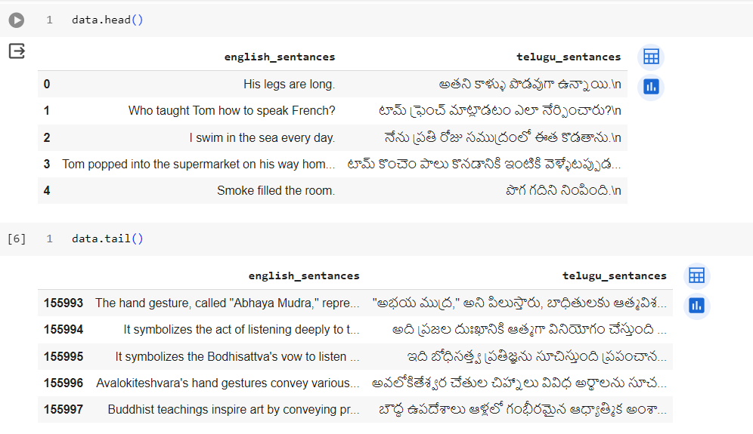
TRANSLATION TRAINING DATASET

Slide 14
TRANSLATION PROCEDURE
1.PRE-PROCESSING
Text Cleaning: The script includes functions for cleaning and preprocessing the text. This typically involves removing unnecessary punctuation, converting text to lowercase, and handling contractions (e.g., converting "can't" to "cannot").
Tokenization and Encoding: Text data is tokenized (converted into sequences of integers) using Keras functionalities. This allows the neural network to process the text.
2.Model Architecture
LSTM Encoder-Decoder: The model architecture consists of an LSTM-based encoder-decoder framework. The encoder reads and encodes the English sentences into a dense vector representation. The decoder then processes this representation to generate sentences in Telugu.
Attention Mechanism: Although not explicitly mentioned in the truncated output, such models often include an attention mechanism to improve the translation by focusing on relevant parts of the input sequence when predicting each word of the output sequence.

Slide 15
ENCODER – DECODER USING LSTM
ENCODER
# Encoder
encoder_inputs = Input(shape=(None,))
enc_emb = Embedding(num_encoder_tokens, latent_dim, mask_zero = True)(encoder_inputs)
encoder_lstm = LSTM(latent_dim, return_state=True)
encoder_outputs, state_h, state_c = encoder_lstm(enc_emb)
# We discard `encoder_outputs` and only keep the states.
encoder_states = [state_h, state_c]

Slide 16
DECODER
# Set up the decoder, using `encoder_states` as initial state.
decoder_inputs = Input(shape=(None,))
dec_emb_layer = Embedding(num_decoder_tokens, latent_dim, mask_zero = True)
dec_emb = dec_emb_layer(decoder_inputs)
# We set up our decoder to return full output sequences,
# and to return internal states as well. We don't use the
# return states in the training model, but we will use them in inference.
decoder_lstm = LSTM(latent_dim, return_sequences=True, return_state=True)
decoder_outputs, _, _ = decoder_lstm(dec_emb,
initial_state=encoder_states)
decoder_dense = Dense(num_decoder_tokens, activation='softmax')
decoder_outputs = decoder_dense(decoder_outputs)
# Define the model that will turn
# `encoder_input_data` & `decoder_input_data` into `decoder_target_data`
model = Model([encoder_inputs, decoder_inputs], decoder_outputs)

Slide 17
Model HYPER- PARAMETERS
# compile the model
model.compile(optimizer='rmsprop', loss='categorical_crossentropy', metrics=['acc’])
batch_size = 128
epochs = 20
train_samples_steps = len(X_train) // batch_size
val_samples_steps = len(X_test) // batch_size
# Defining a helper function to reduce the learning rate each time
# the learning plateaus
reduce_alpha = ReduceLROnPlateau(monitor ='val_loss', factor = 0.2,patience = 1, min_lr = 0.001)
# stop traning if there increase in loss
es = EarlyStopping(monitor='val_loss', mode='min', verbose=1,patience=2)
callbacks = [checkpoint, es, reduce_alpha]
# in which the loss decreases
filepath = project_path+'NMT_model_enc_dec.h5'
checkpoint = ModelCheckpoint(filepath, monitor='val_loss', verbose=1, save_best_only=True, mode='min')

Slide 18
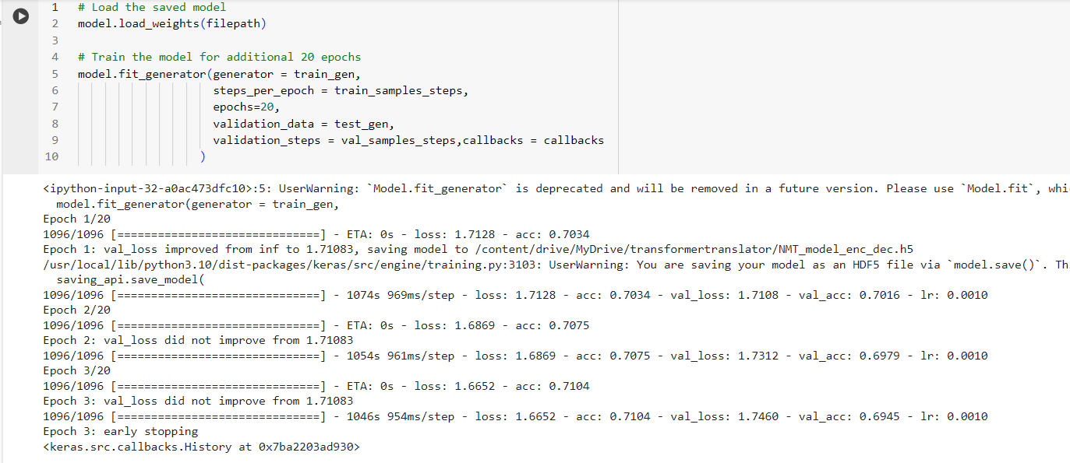
Translation results

Slide 19
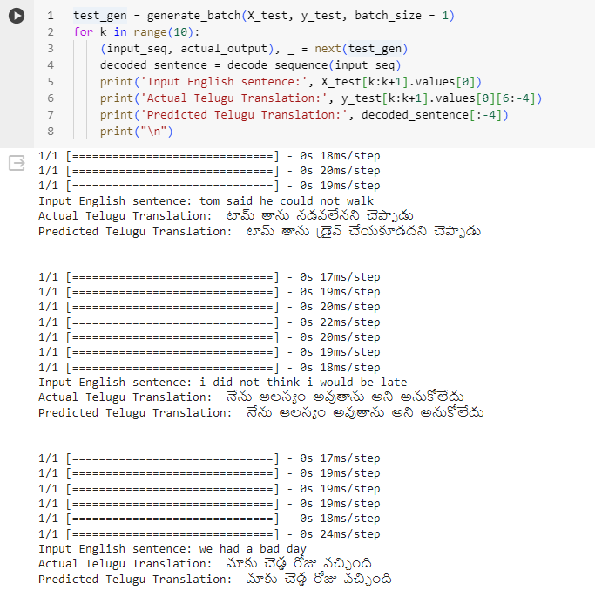
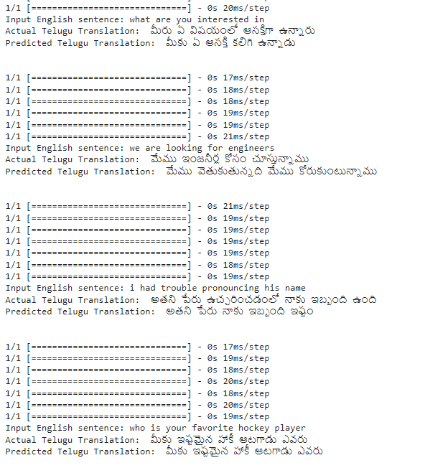
Translation results

Slide 20

MODEL TRAINING
DL FOR NLP

Slide 21
process of fine-tuning the LLaVA model from Hugging Face, integrating adapters, and preparing the model for deployment
Environment Setup and Data Preparation
to import data sources
data collator
Model Configuration and Training Setup
Training Arguments
Model Fine-Tuning with Adapters
Training and Evaluation
Model Training
Push to Hub
Inferencing
Model Loading
Prepare for Inference

Slide 22
MODEL FINE TUNING HYPERPARAMETERS
training_args = TrainingArguments(
output_dir="llava-1.5-7b-hf-ft-mix-vsft",
report_to="tensorboard",
learning_rate=5e-5,
per_device_train_batch_size=2,
gradient_accumulation_steps=1,
logging_steps=5,
num_train_epochs=10,
push_to_hub=True,
gradient_checkpointing=True,
remove_unused_columns=False,
fp16=True,
bf16=False
)
lora_config = LoraConfig(
r=64,
lora_alpha=16,
target_modules="all-linear"
)

Slide 23
Model deployment – with gradio
Setup Gradio Interface: Gradio is commonly used to create easy-to-use interfaces for machine learning models.
The setup usually involves defining the input and output interfaces, such as:
Inputs: Text field for the question and an image upload option.
Output: Text field to display the answer.
Function Definition: A function that takes an image and a question as inputs and returns the model's answer would be connected to the Gradio interface. This function handles the complete pipeline of processing inputs, performing inference, and formatting the output.

Slide 24
Model ui

Slide 25
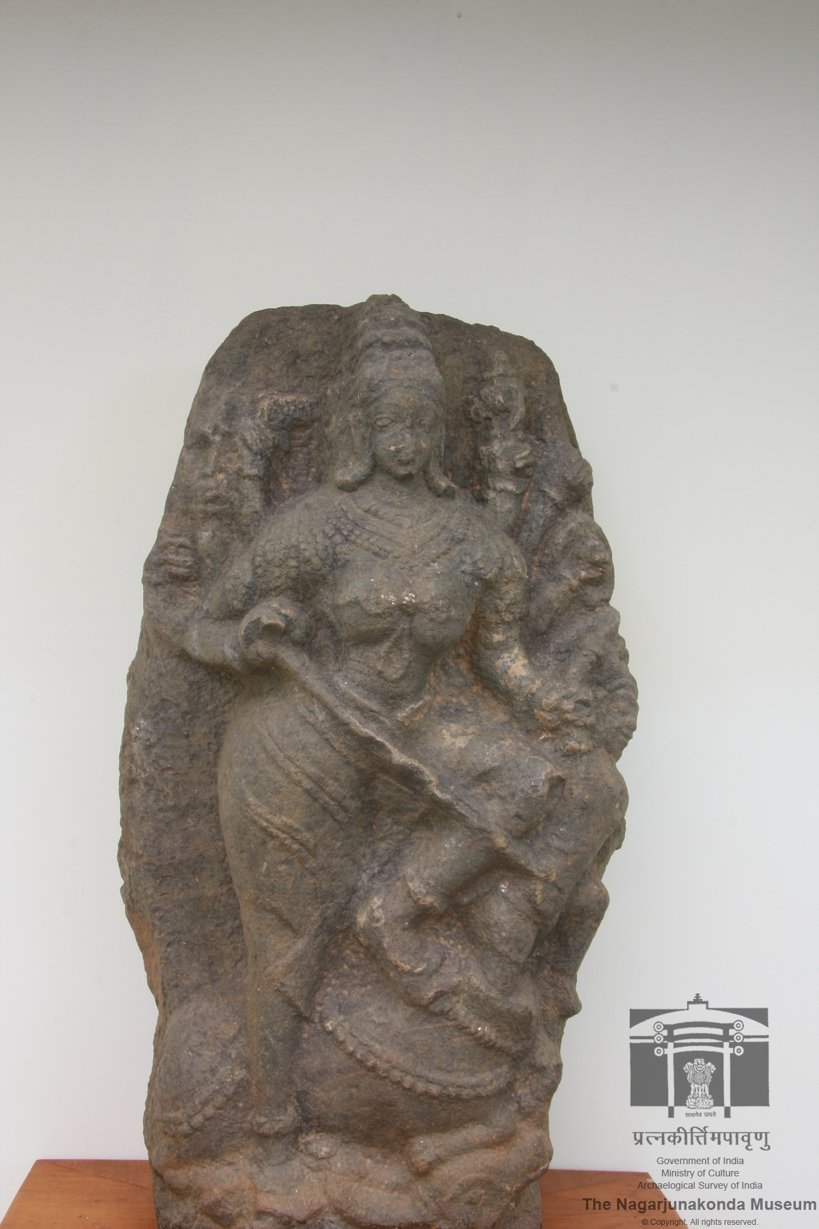
THANK YOU

